Slide 1
Term Project for
CS673 – Software Engineering
Focused Study
(Iteration 2)
Project Presentation by
Siddhesh Dighe
Paridhi Talwar
Deepali Chawla
Pushkar Gharat
Sai Ramya Devineni
Ayush Bhaliya
Supriya

Slide 2
Team Members
Siddhesh Dighe - Team Leader Paridhi Talwar - Requirement Leader
Deepali Chawla- Configuration Leader Pushkar Gharat - Design Implementation Leader
Sai Ramya Devineni - QA Leader
Supriya - Backup QA Leader
Ayush Bhaliya - Security Leader

Slide 3

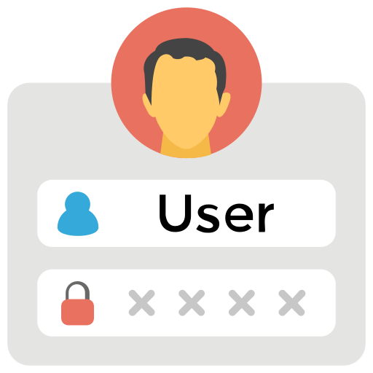


Focus for Iteration 2
Designing Webpages
Login functionality
Server-side
Implementation
Overall App flow

Slide 4
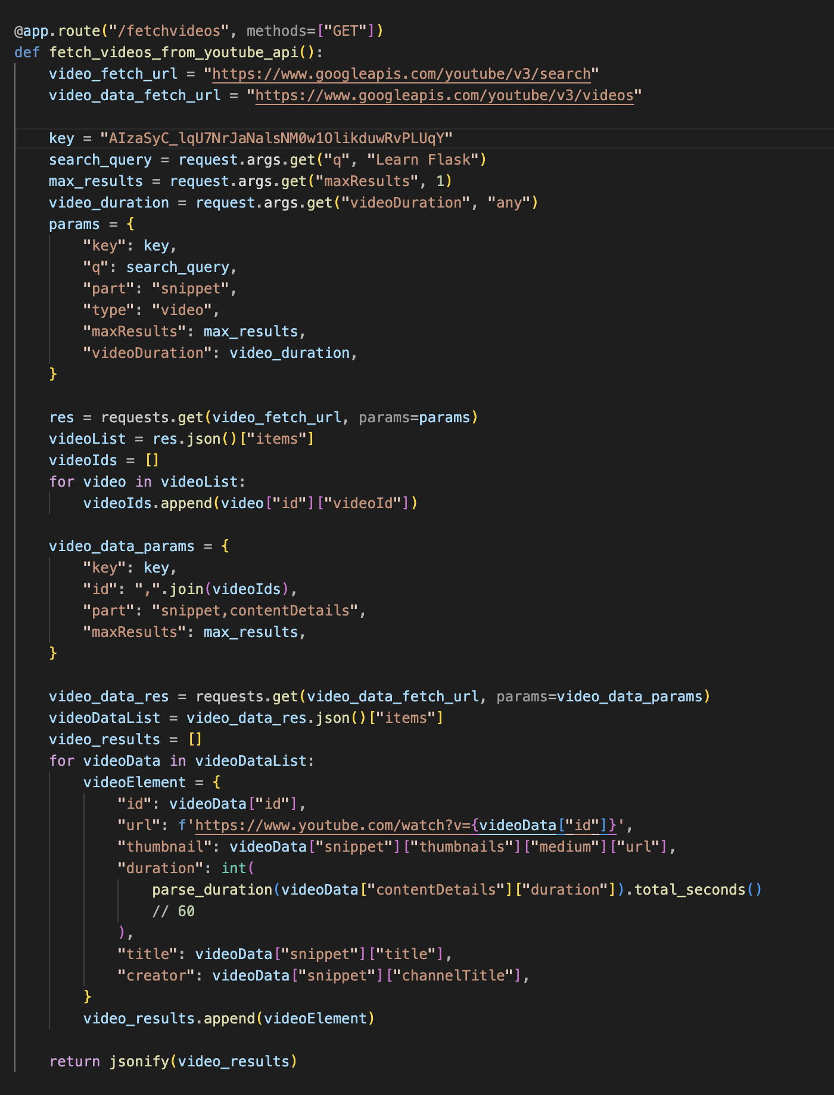
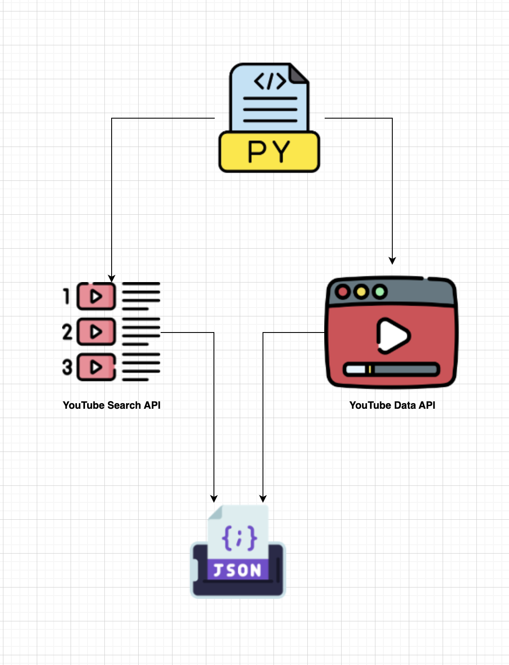
Code Walkthrough – Video Fetch Logic

Slide 5
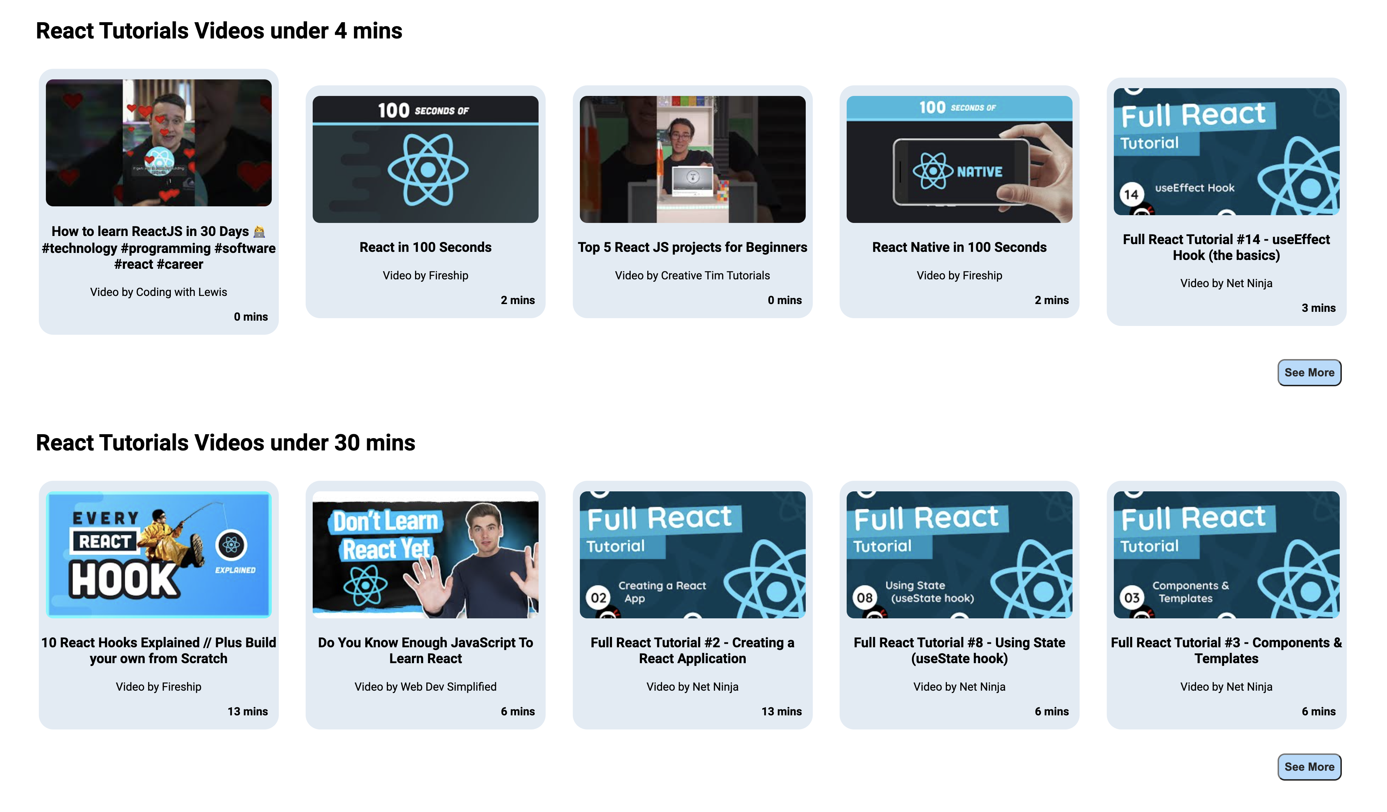
Code Walkthrough – Reusable Components

Slide 6
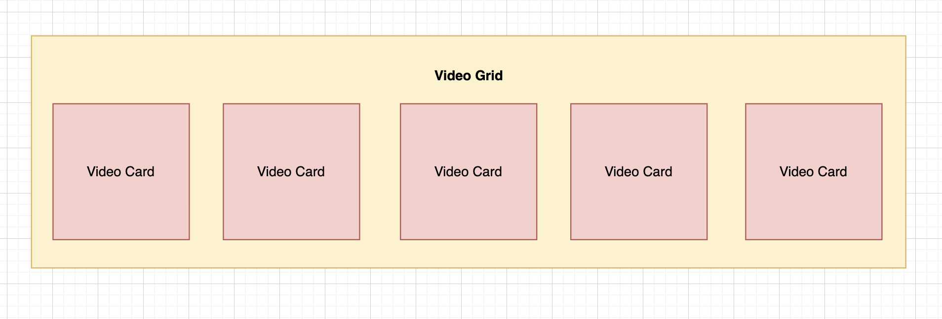
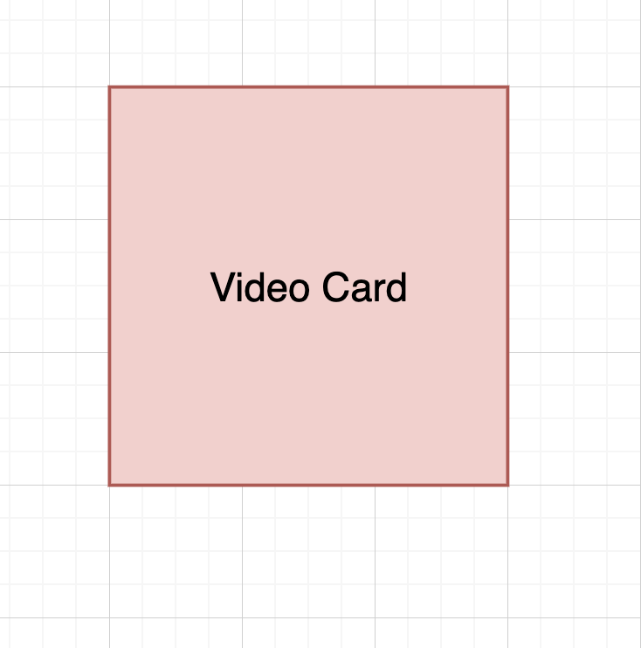
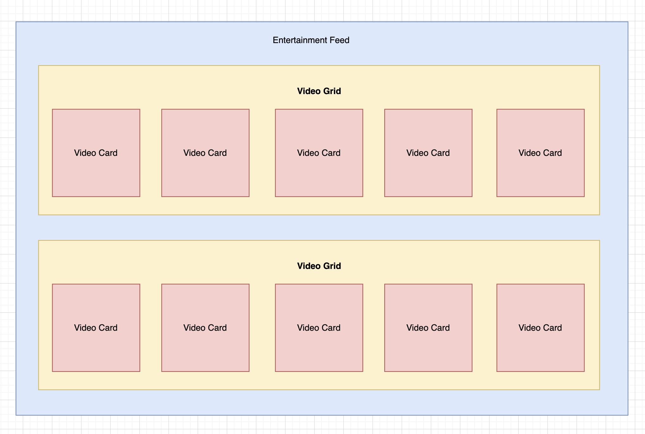

Slide 7
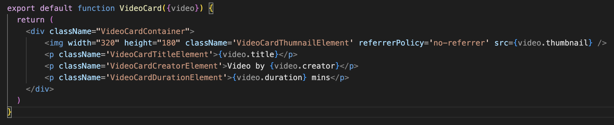
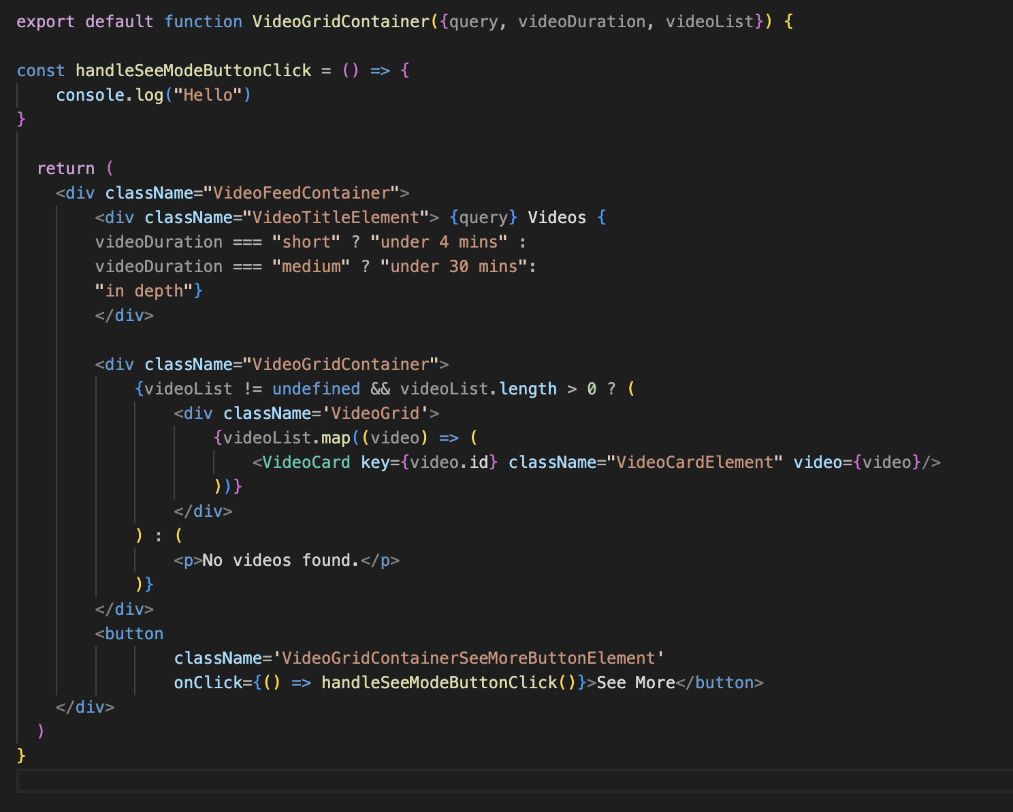
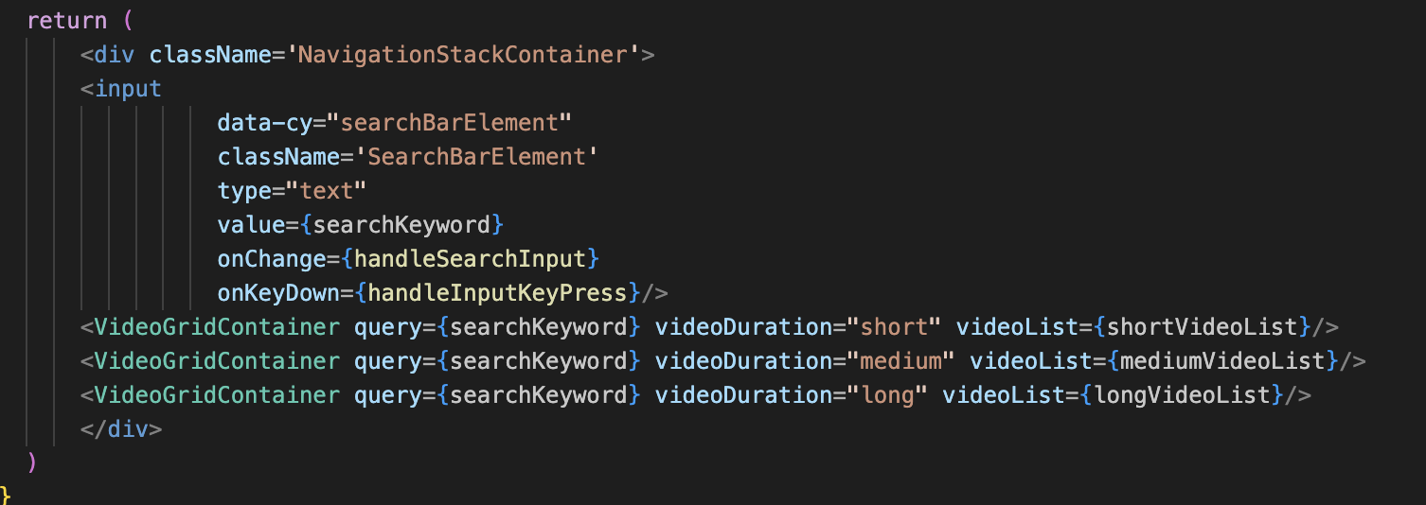
Video Card Component
Education Feed Component
Video Grid Component

Slide 8
Problem with YouTube API
Each search is 10 Units
10,000 Daily Units Quota
100 Fetch Per Day

Slide 9
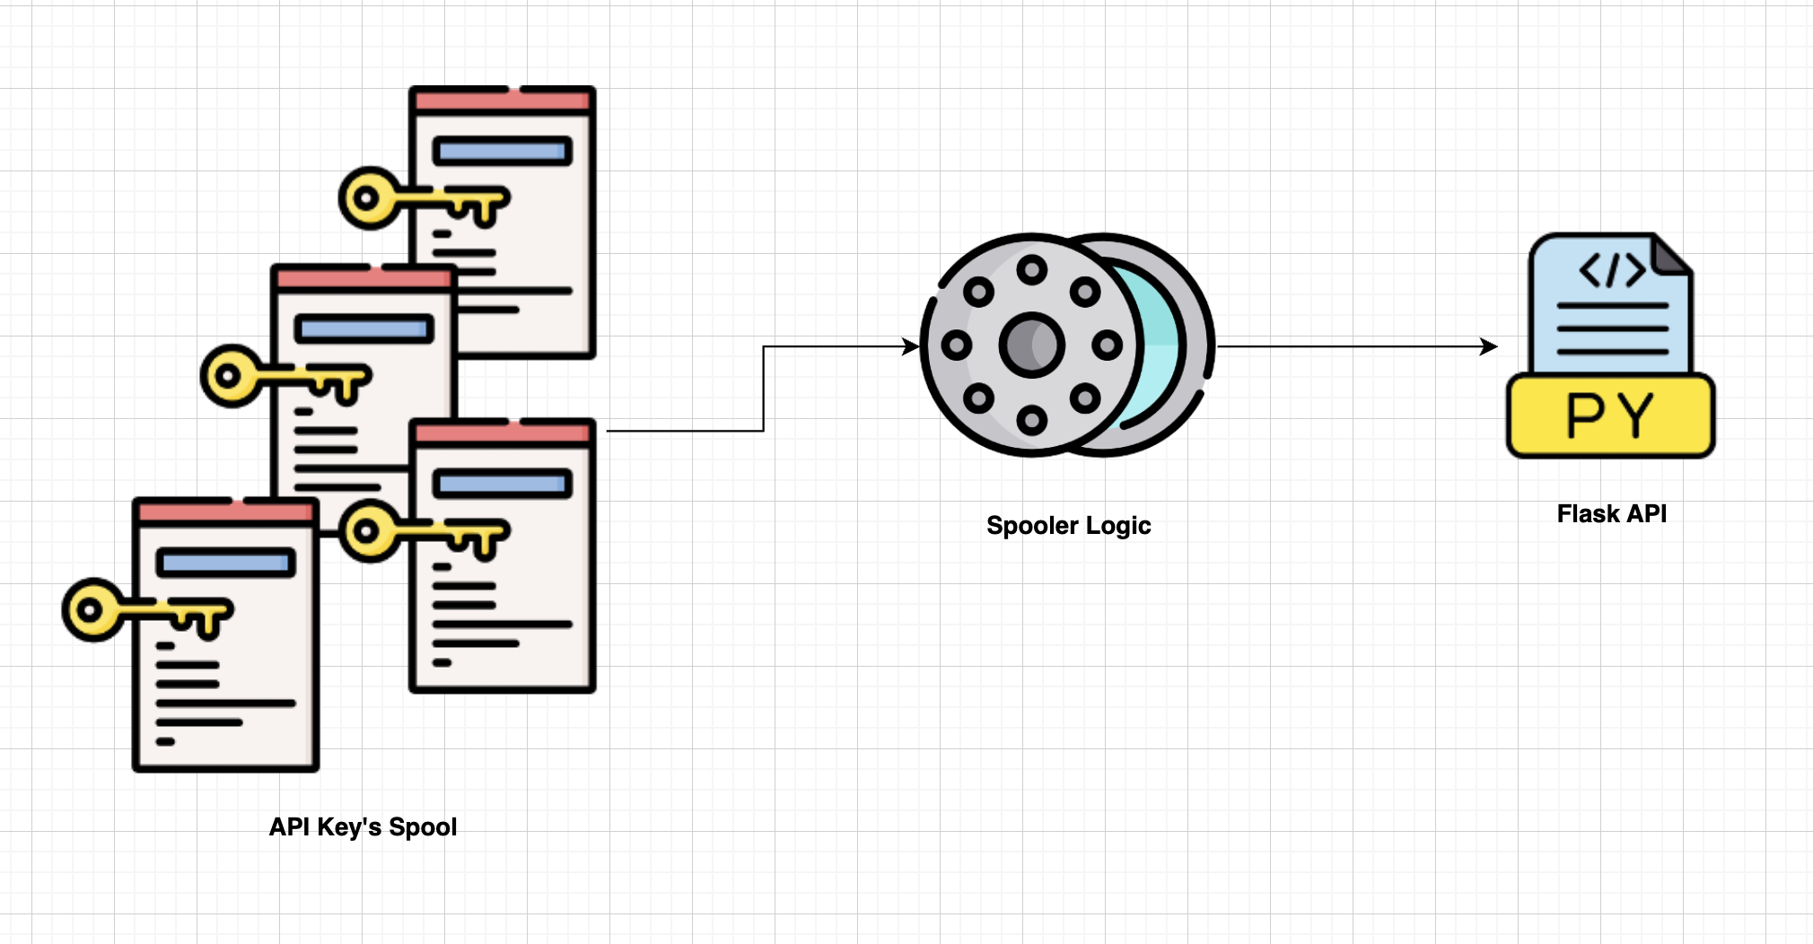
Problem with YouTube API
Each search is 10 Units
10,000 Daily Units Quota
100 Fetch Per Day

Slide 10
Focus for Iteration 3
1. Visualization of User’s watch time & learning patterns
2. Earning & Spending Reward points

Slide 11
Thank You

